Slide 1
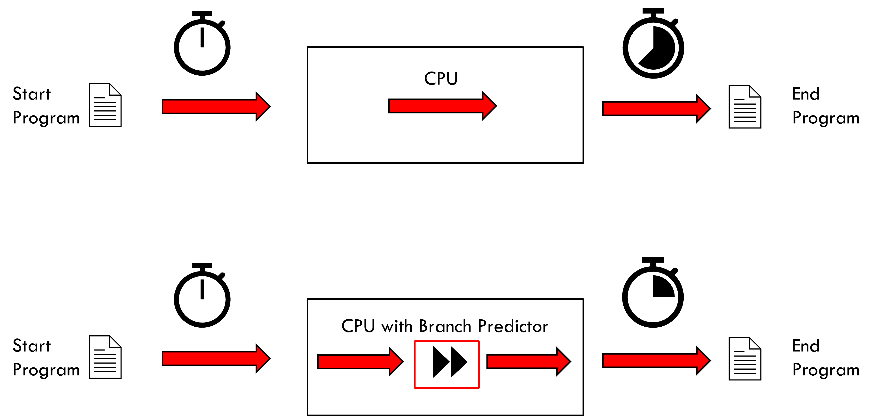

Dynamic Branch Predictor Using Machine Learning
Aharon Tzur
שנקר - בי"ס גבוה להנדסה ועיצוב

Slide 2
Introduction
Scope:
Modern CPU architectures utilize pipeline processing by staging every command to be handled in several steps such that the clock frequency can be boosted up, which will shorten the overall execution times of programs.
A branch predictor is required to maximize the successful prediction rate, thus accelerating the program execution.
Description:
Design and implement a pipelined RISC CPU (MIPS Architecture)
Design 2 versions of a branch prediction unit, one of them using machine learning technique (perceptron).
Running sorting programs (benchmarks) and compare the solutions in terms of performance

Slide 3
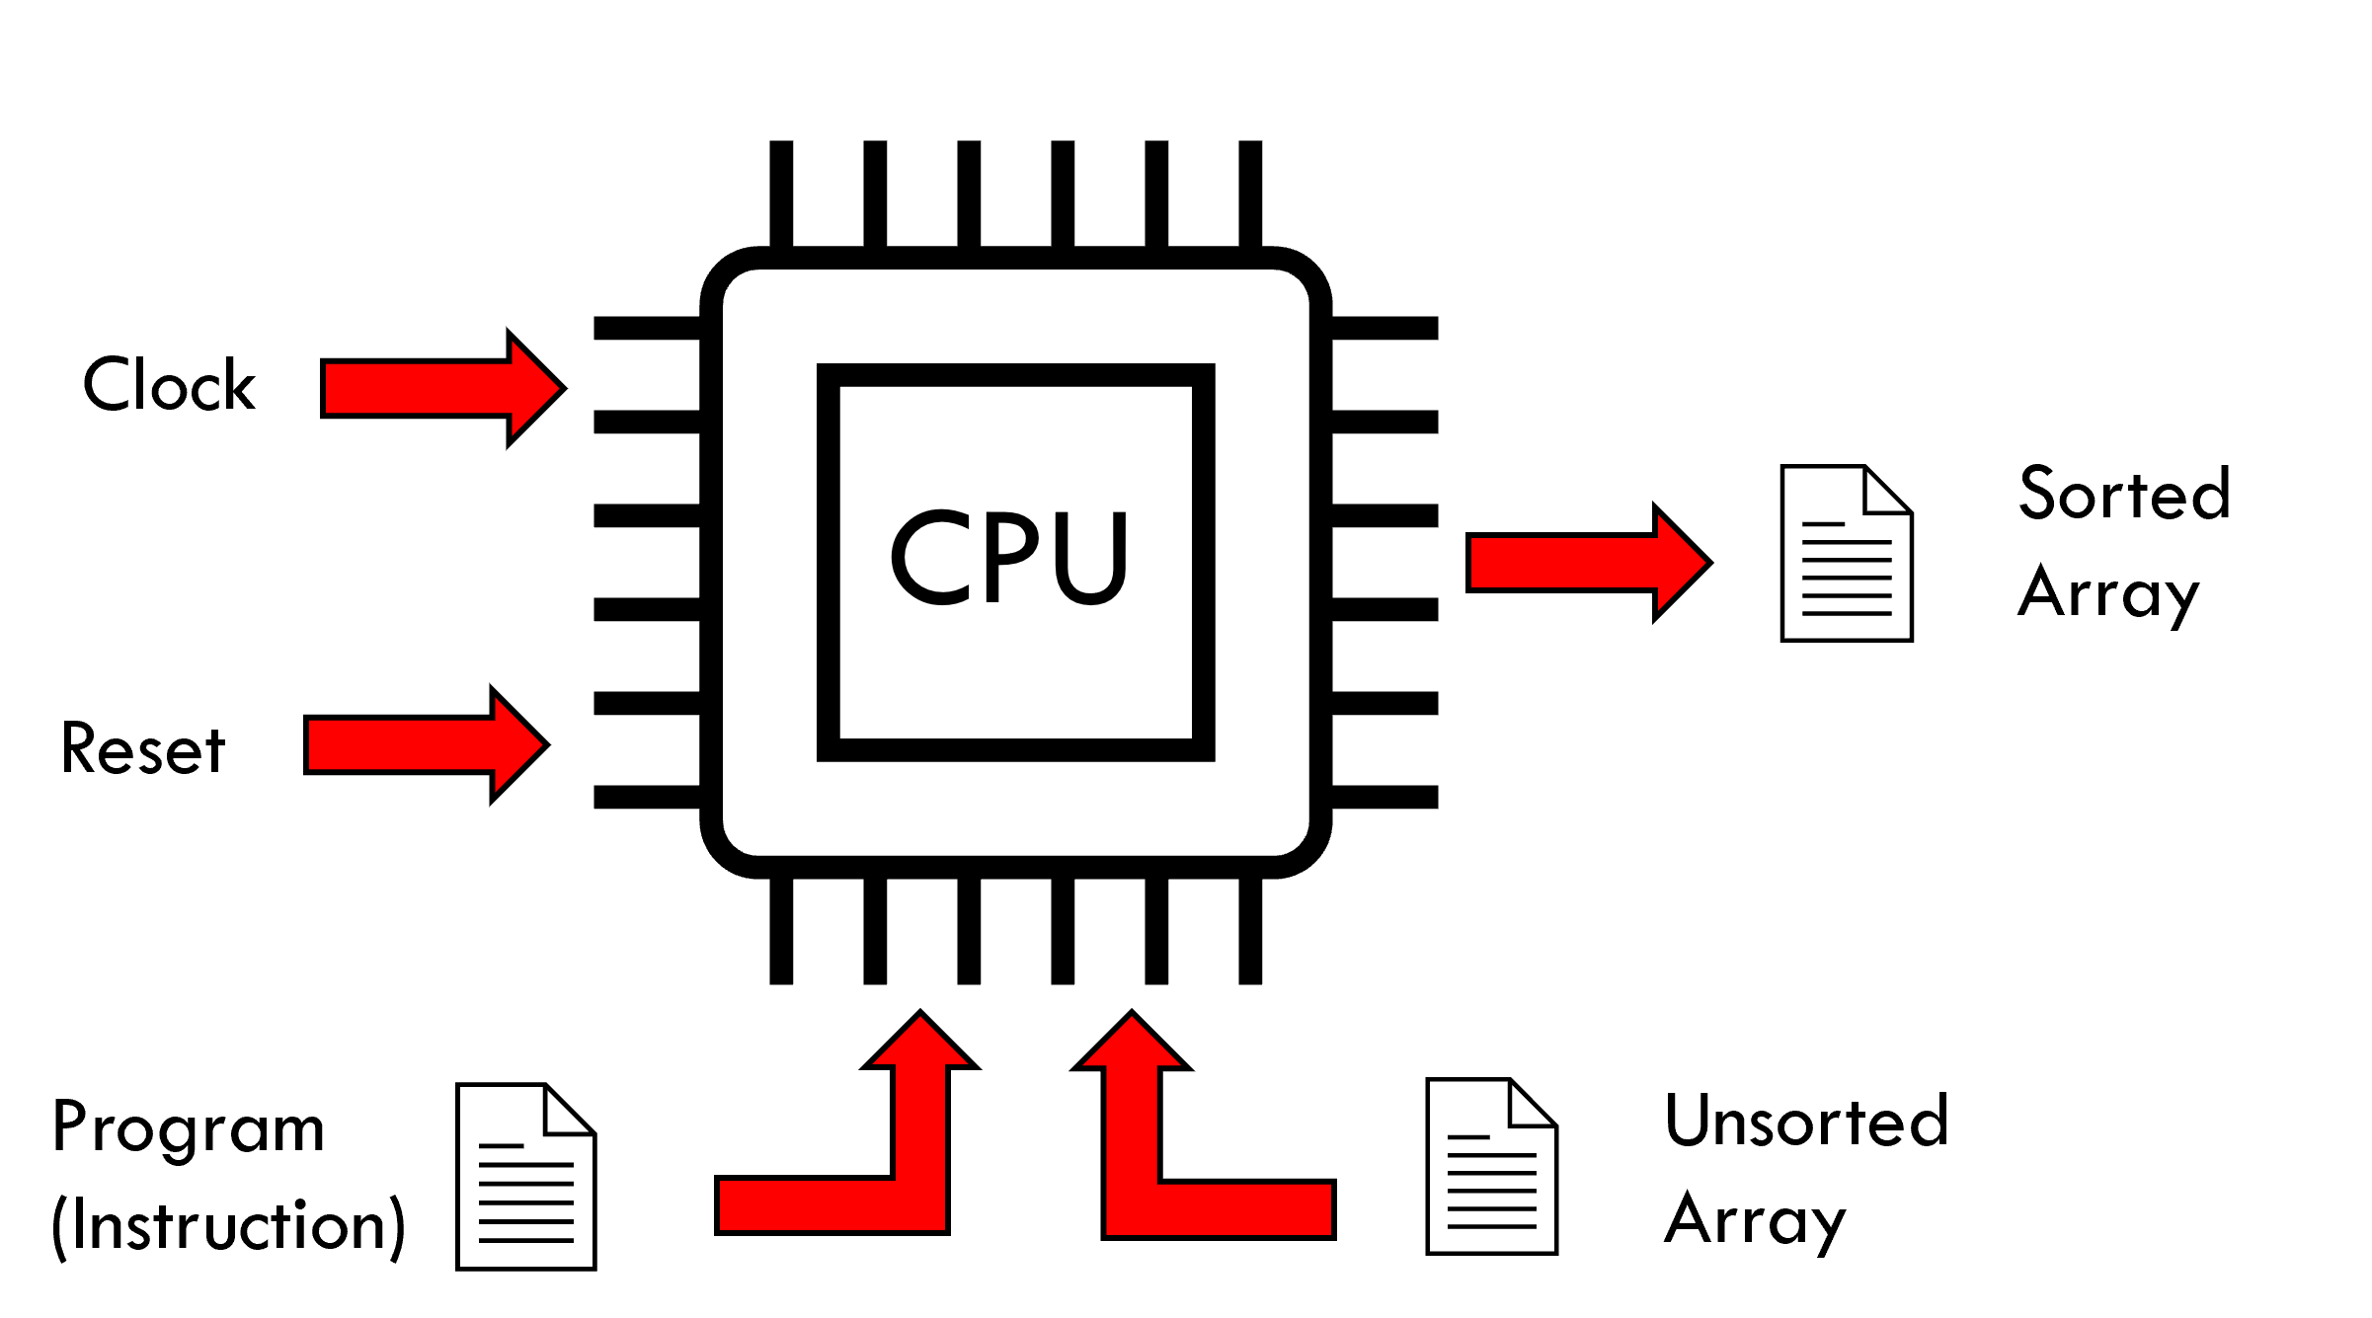
Use Case

Slide 4


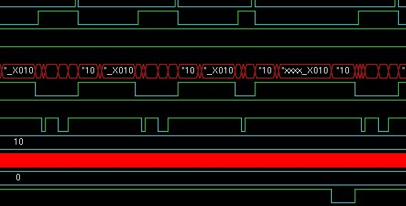
Output Program Assembly language
Engineering design
Test Bench (Verilog + System Verilog)
Modelsim
(Simulator)
Top (CPU) – Verilog language
Input Program Assembly language
Instructions Assembly language
Data Ram
Instruction Ram
Program Counter
Simulation results (Monitor)
ALU
Flush
Control Unit
Register File
IF/ID
ID/EX
Branch Predictor
Select PC
Learning Unit
Prediction Unit

Slide 5
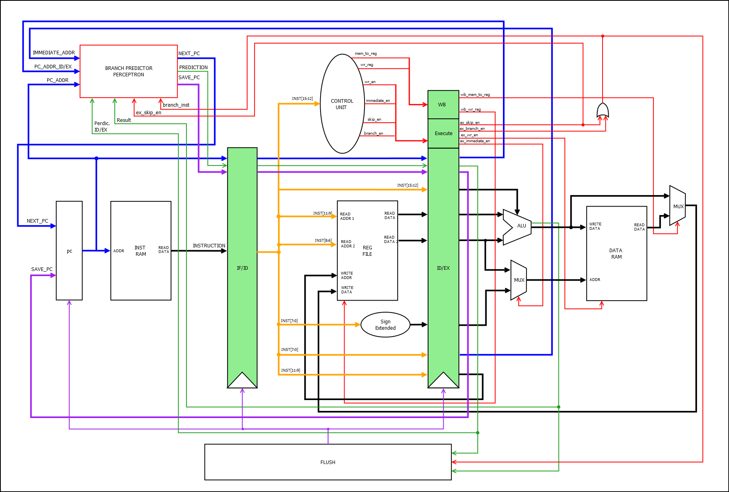

Pipeline + Branch Predictor (Architecture)
Clock
Sorted Array
Reset
Instruction file
Unsorted Array

Slide 6
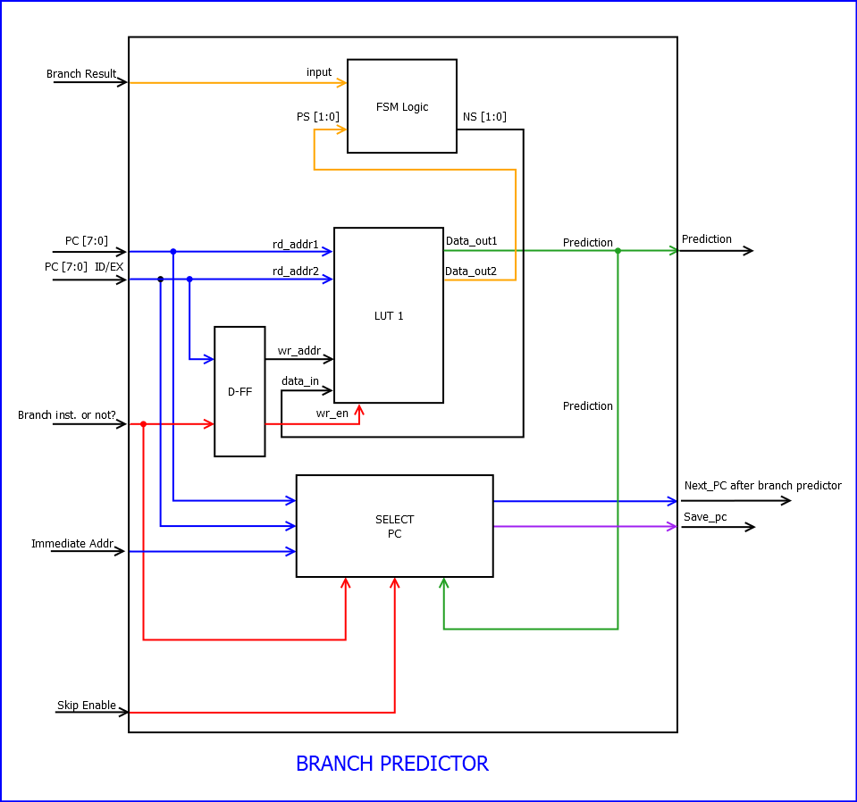
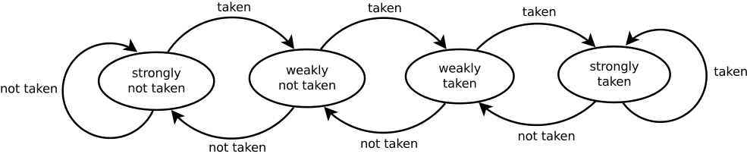
Branch Predictor – Simple (Architecture)

Slide 7
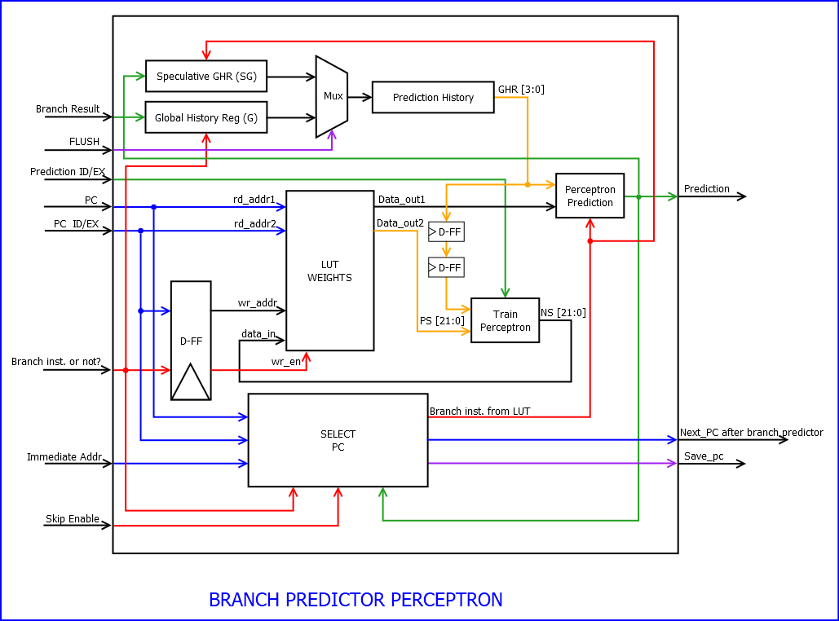
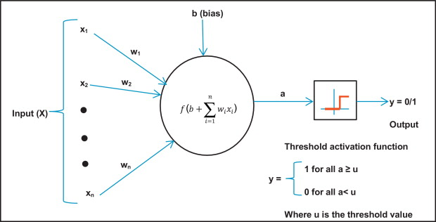
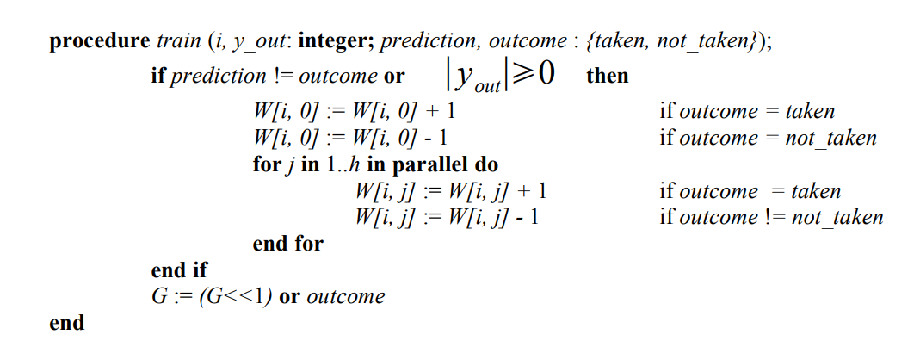
Branch Predictor - Perceptron (Architecture)
Prediction Algorithm
Learning Algorithm

Slide 8
Validation
1. System integrity:
*All the results are for Bubble sort but were test also in selection sort

Slide 9
Validation
2. Perceptron Hit Ratios With Different History Length:
Expected results are based on Dynamic Branch Prediction Using Machine Learning by Yu Wang & Lei Chen from Department of Computer Science University of California, Davis

Slide 10
Validation
3. Different size of arrays:

Slide 11
Issues and their solutions
Predication to normal operation
Negative results to success rate
Path solution for wrong prediction

Slide 12
Thanks!
Any question?

Slide 13
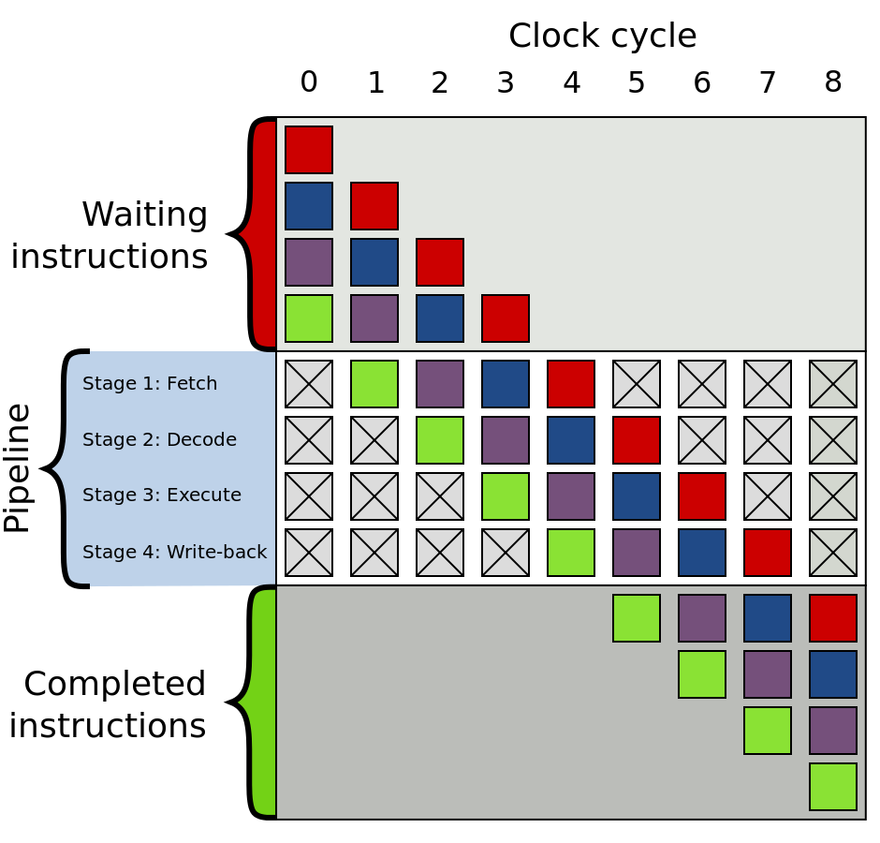
Branch Predictor using pipeline:
Branch Predictor - The processor can guess from which branching to bring the following instructions. If it turns out that he chose wrong he cancels the unnecessary calculations. In case of guessing true performance was improved.
Example of 4-stage pipeline. The colored boxes represent instructions independent of each other

Slide 14
Implementations of Various Predictors:
Perceptron is one basic type of ANN (artificial neural networks) system. A perceptron takes a vector of real valued inputs, calculates a linear combination of these inputs, then outputs 1 if the result is greater than some threshold and 0 otherwise
Prediction with perceptron - The perceptron branch predictor keeps a global history shift register that records the outcomes of branches as they are executed.
Prediction with Bit Priority – with 2-bit branch prediction accuracy (state machine)
Perceptron Diagram block Model
Bit priority block Model

Slide 15
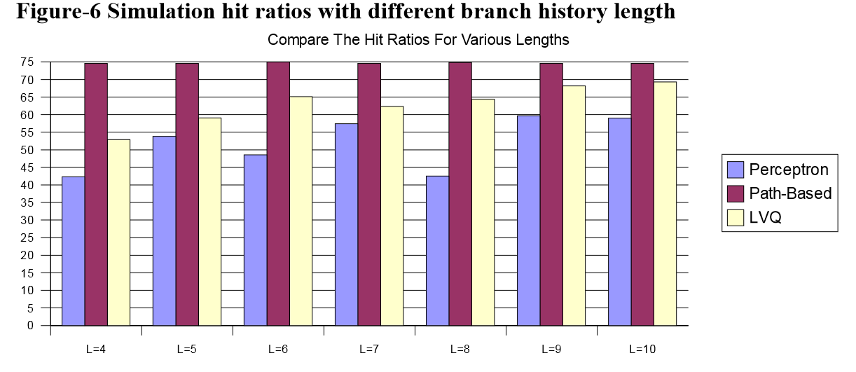
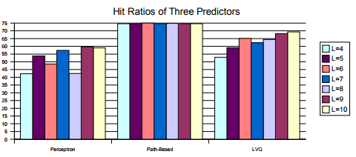
Predicted Conclusions
Hit Ratios With Different History Length (%) |  |  |  |  |  |  | benchmark | Predictors
L=10 | L=9 | L=8 | L=7 | L=6 | L=5 | L=4
59 | 59.7 | 42.5 | 48.6 | 53.8 | 53.8 | 42.3 | Bubble Sort | Perceptron
74.6 | 74.6 | 74.8 | 74.6 | 75 | 74.6 | 74.6 | Bubble Sort | Path - Based
69.3 | 68.2 | 64.4 | 62.3 | 65.1 | 59.1 | 52.9 | Bubble Sort | LVQ
Based on Dynamic Branch Prediction Using Machine Learning by Yu Wang & Lei Chen from Department of Computer Science University of California, Davis

Slide 16
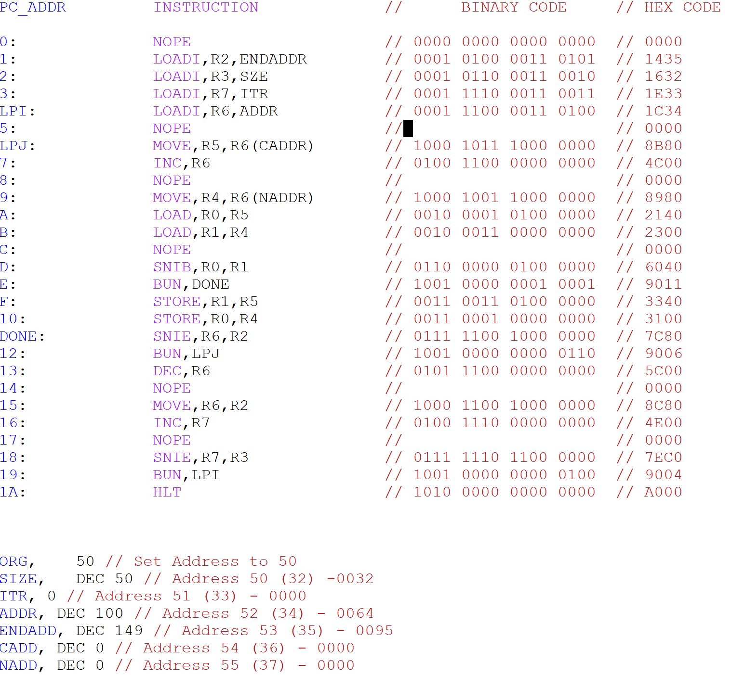
Assembly code
Address | Data | Comments
0000 | DEAD | This address contains fake data to verify when the address is 0 (for verification only)
0001- 0049 | XXXX | No data
0050 | 0032 | This address contains the array size
0051 | 0000 | This address contains the Iteration
0052 | 0064 | This address contains the first address on the array (100)
0053 | 0095 | This address contains the last address on the array (150)
0054 | 0000 | This address contains the current address in the array
0055 | 0000 | This address contains the next address in the array
0056-0099 | XXXX | No data
0100-0149 | The array | These addresses contain the array
0150-FFFE | XXXX | No data
FFFF | BEEF | This address contains fake data to verify when the address is FFFF (for verification only)

Slide 17
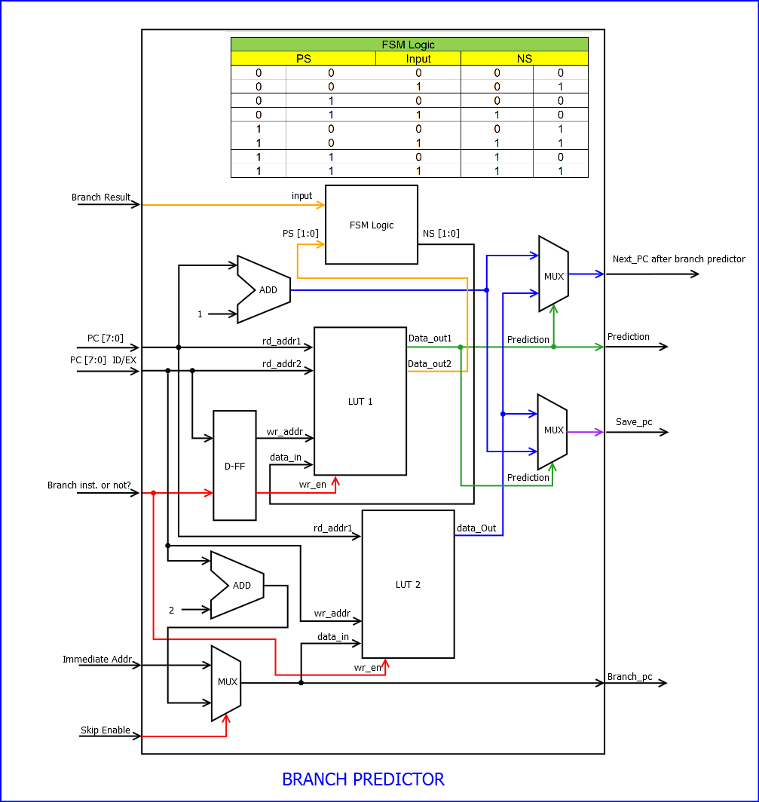
Branch Predictor (Bit Priority):
LUT 1 – scales for each address
LUT 2 – next address base instruction

Slide 18
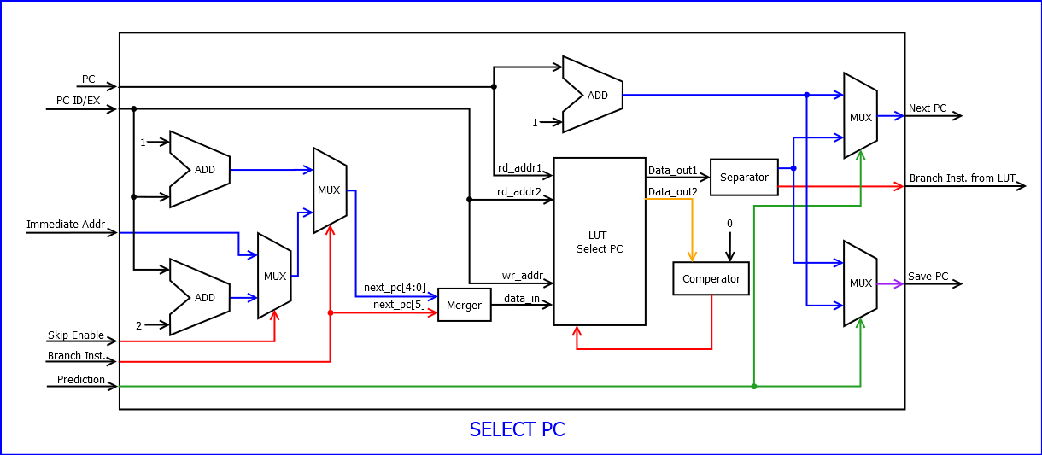
Branch Predictor (Perceptron) + Select PC:

Slide 19
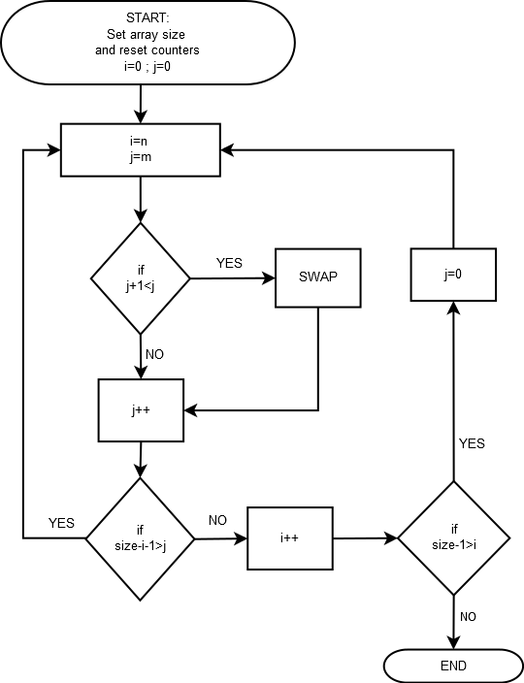
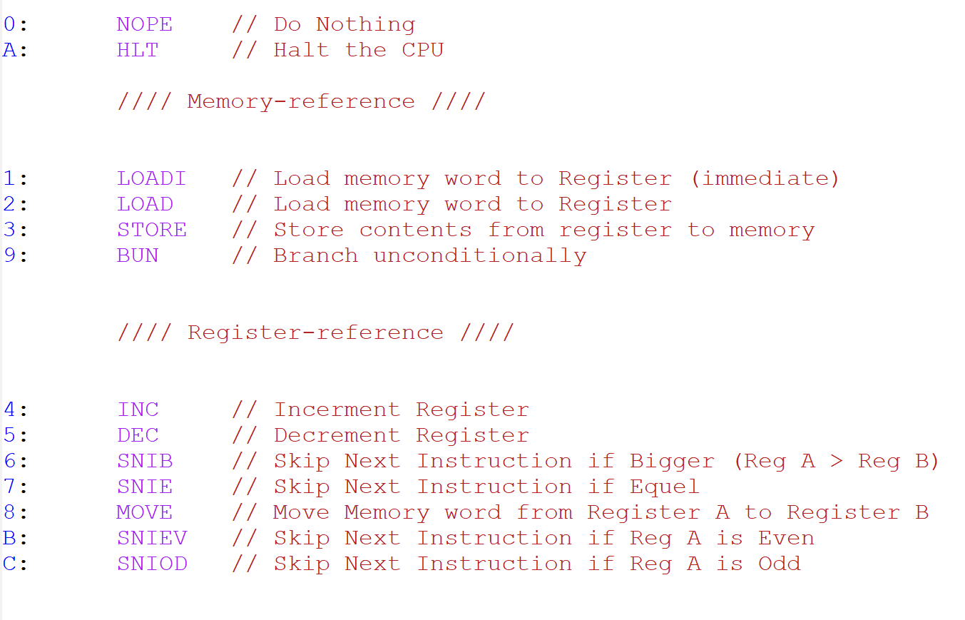
Flowchart + Instruction set architecture (ISA)

Slide 20
The registers
Information | Reg Number
The data on the current address | 0
The data on the next address | 1
End address | 2
Size of the Array | 3
The Next Address | 4
The Current address | 5
The Address | 6
The current iteration | 7

Slide 21
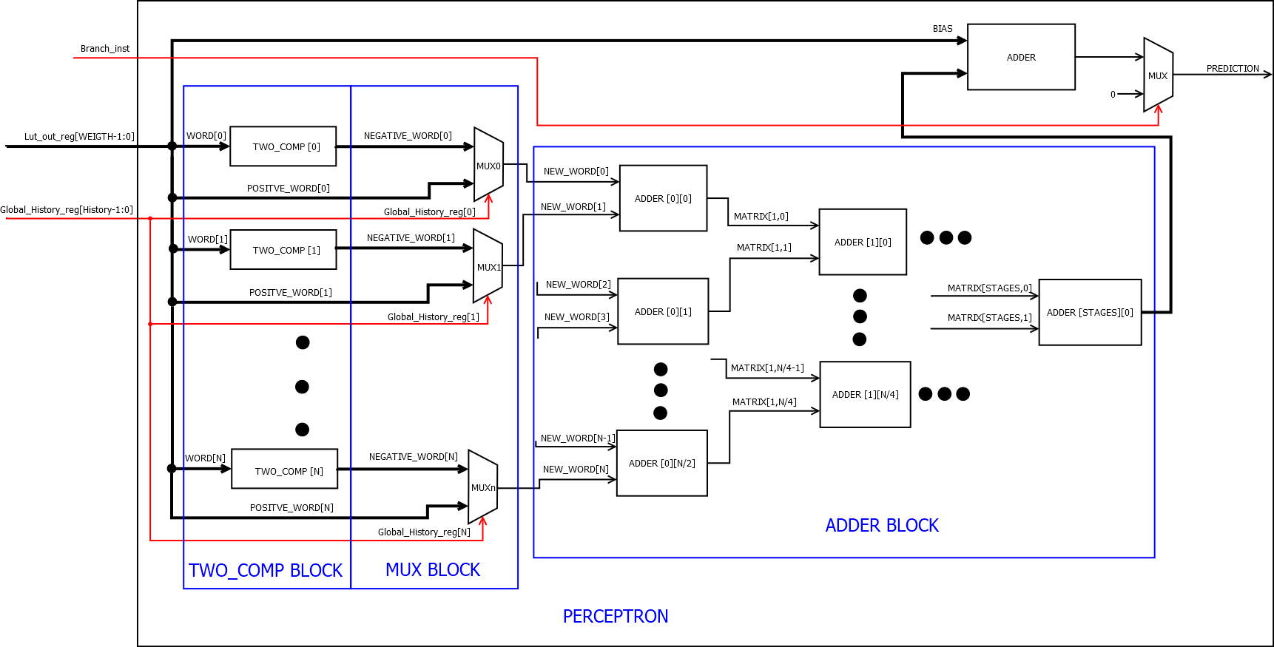
Predication to normal operation – with solution

Slide 22
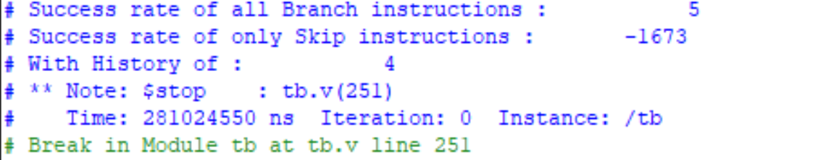
Negative results to success rate
count1 = branch instructions counter;
count2 = flush counter;
count3 = skip instructions counter;
count4 = flush (skip instruction only) counter;
Success Rate of all Branch Instructions = (count1 - count2) * 100 / count1;
Success Rate of all Skip Instructions = (count3 - count4) * 100 / count3

Slide 23
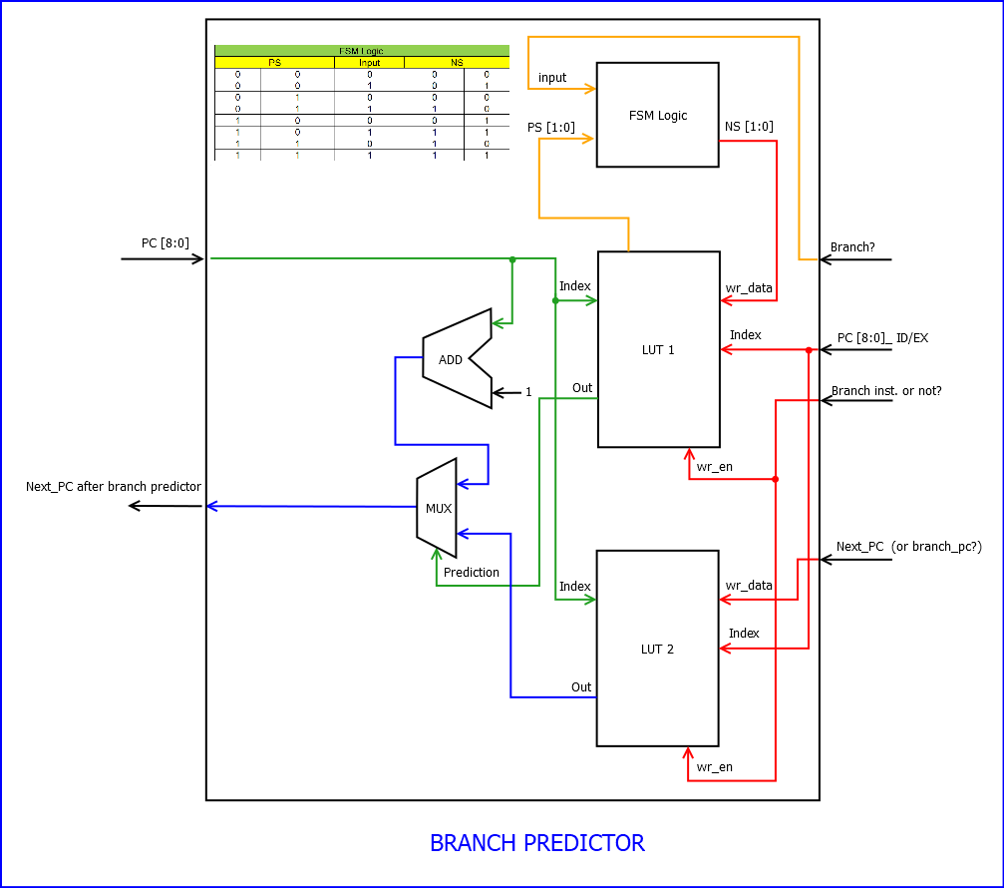
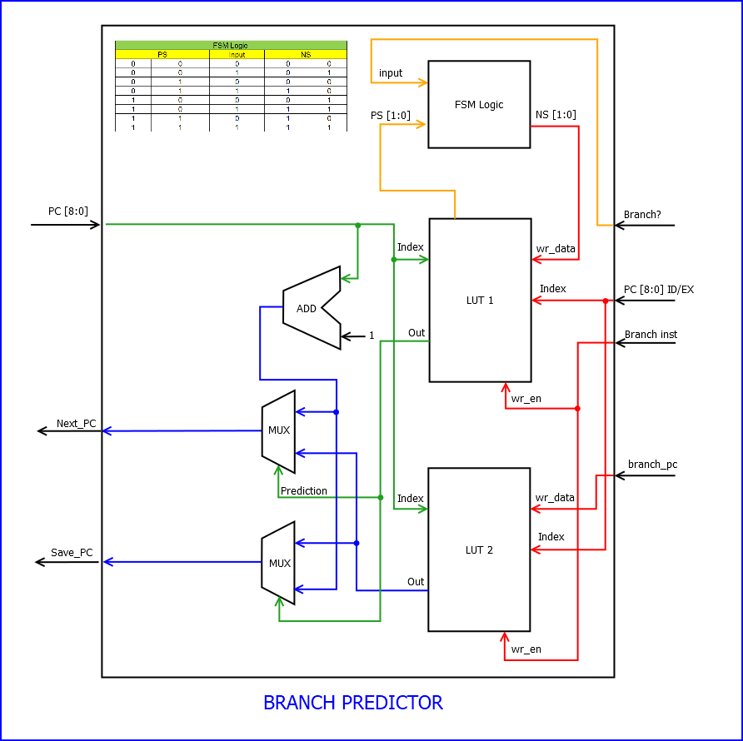
Branch Predictor (Bit Priority) – previous versions
LUT 1 – scales for each address
LUT 2 – next address base instruction

Slide 24
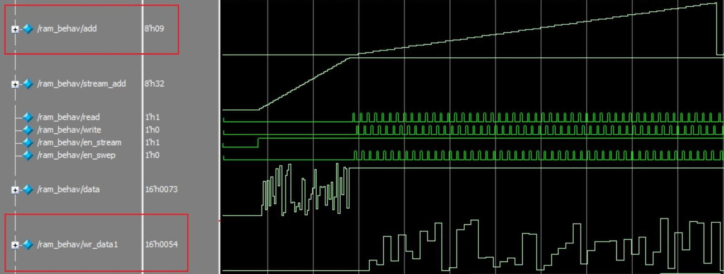
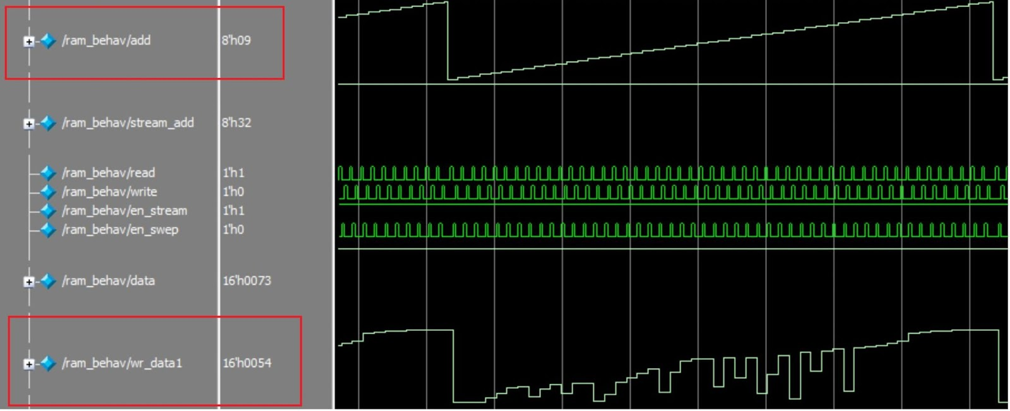
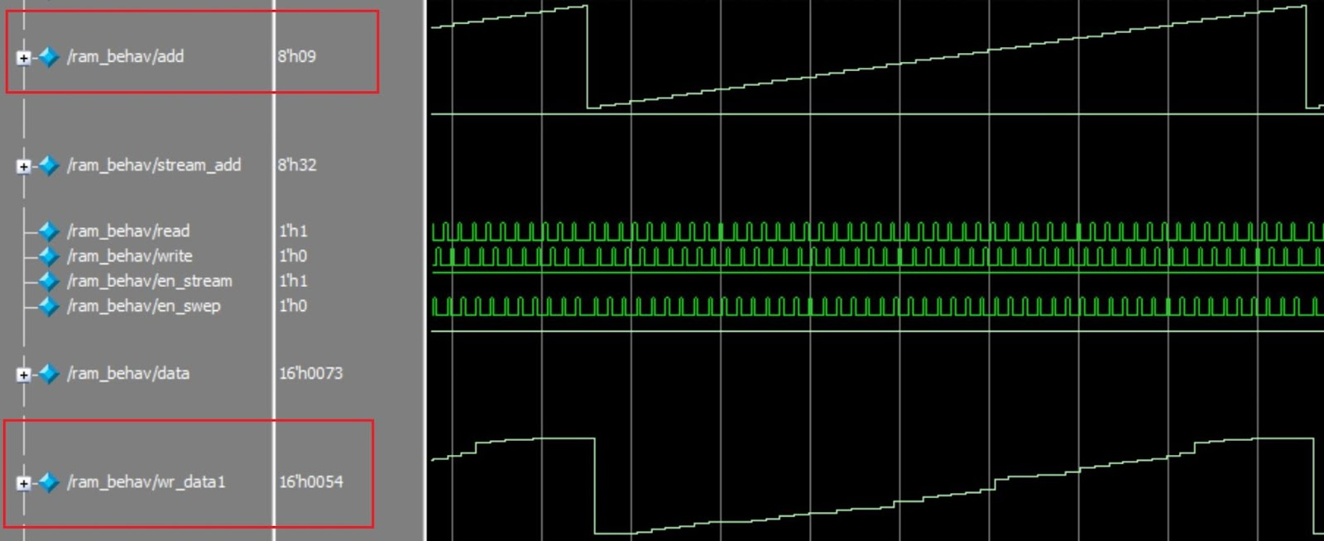
Data Ram results
Start
Middle
End

Slide 25
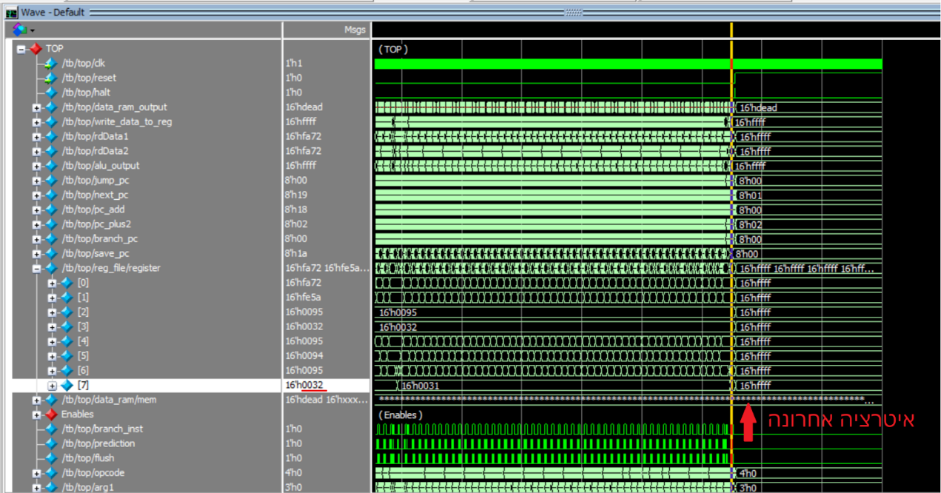
End Simulation

Slide 26
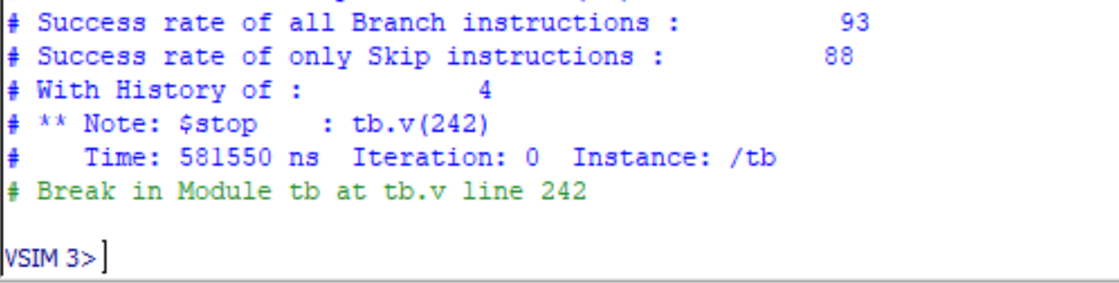
Conclusion results
count1 = branch instructions counter;
count2 = flush counter;
count3 = skip instructions counter;
count4 = flush (skip instruction only) counter;
Success Rate of all Branch Instructions = (count1 - count2) * 100 / count1;
Success Rate of all Skip Instructions = (count3 - count4) * 100 / count3

Slide 27
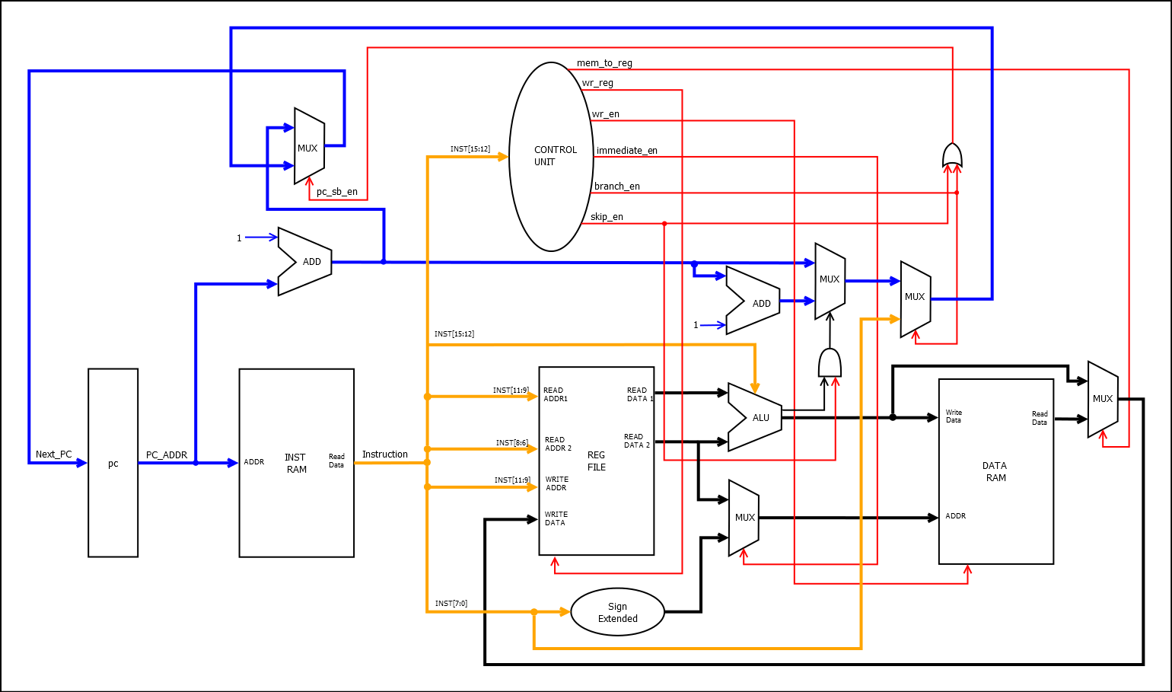
Single Cycle (Architecture)
Clock
Sorted Array
Reset
Unsorted Array
Instruction file

